Slide 1
ME469: A Verification and Validation (V&V) Methodology (Review)
Stefan P. Domino^{1,2}
¹ Computational Thermal and Fluid Mechanics, Sandia National Laboratories
² Institute for Computational and Mathematical Engineering, Stanford
SAND2018-4536 PE

Slide 2
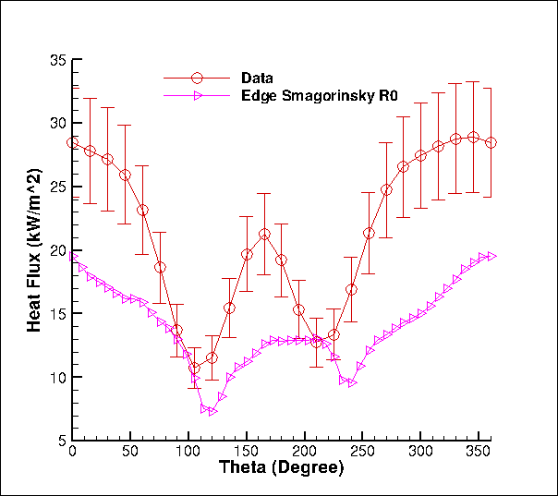
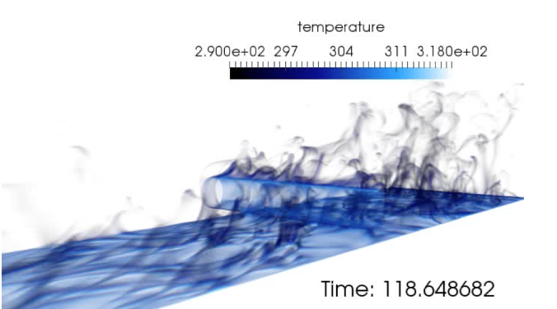
Challenge: Understanding Errors/Uncertainties….
One mesh, one model, unknown code/numerical pedigree…
We need to distinguish the types of errors/uncertainties:
Conceptual uncertainty, δ_{input}
Model-form error/uncertainty, δ_{model}
Discretization Error, δ_{numerical}
Code Error, δ_{numerical}
What credible scientific hypothesis can be tested in this context?
Heat flux to the cylinder
Volume-rendered temperature
Time-averaged heat flux to cylinder

Slide 3
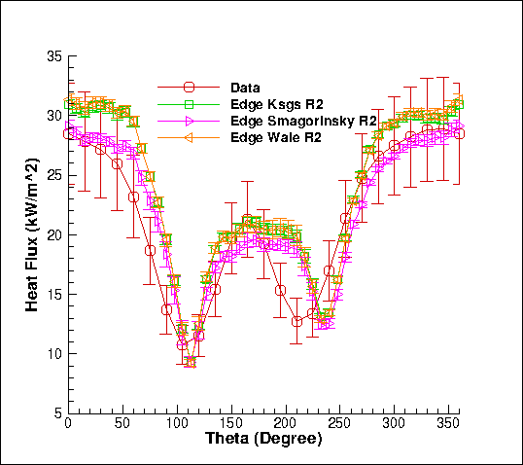
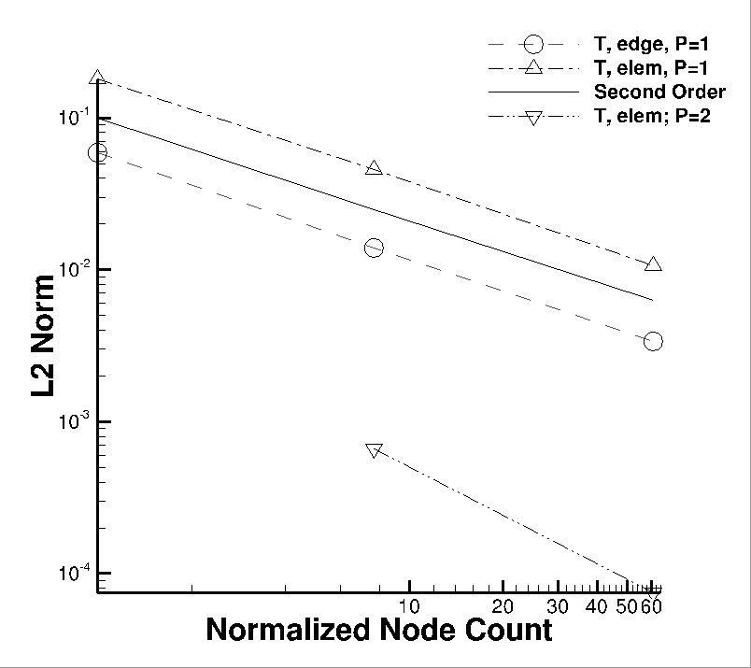
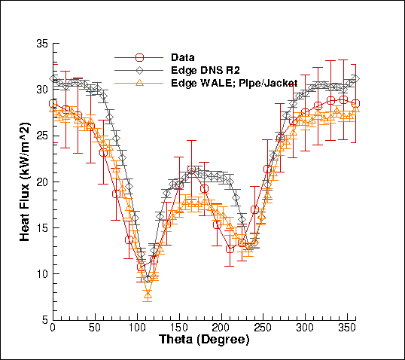
Review of a Strong V&V Process
Numerical UQ
Establish a sound LES-based V&V process (with uncertainty quantification) that includes the following attributes:
Phenomena Identification and Ranking (PIRT)
Code and solution verification (numerical error, δ_{numerical})
Validation including solution sensitivity to model inputs (δ_{input})
Structural uncertainty (model form error, δ_{model})
Physics assumptions (your conceptual model)
Structural UQ
Sources of error and uncertainty in simulation
δ_{numerical} , δ_{input} , δ_{model}
Physics UQ
10x
reduction
Non-isothermal MMS
“An assessment of atypical mesh topologies for low-Mach LES”, Domino et al., Comp & Fluids, 2019

Slide 4
Code or Conceptual Error? Part 1: Time Splitting
Case Study: An Algorithm is thought to be second-order-in-time accurate with one nonlinear iteration: True or False?
Issa, “Solution of the implicitly discretized fluid flow equations by operator splitting”, JCP (1985).
Advent of the “Pressure-implicit with Splitting of Operators”, or PISO
PISO is a scheme that defines a series of predictors and correctors in the context of a fully implicit solve
Conclusion?
Sometimes we code a method correctly, however, have a conceptual error in our understanding of whether or not a scheme is design-order accurate when run in the suggested manner

Slide 5
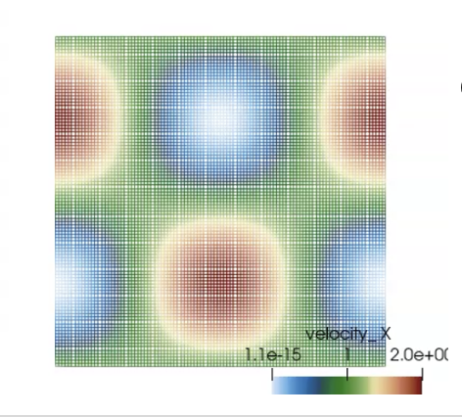
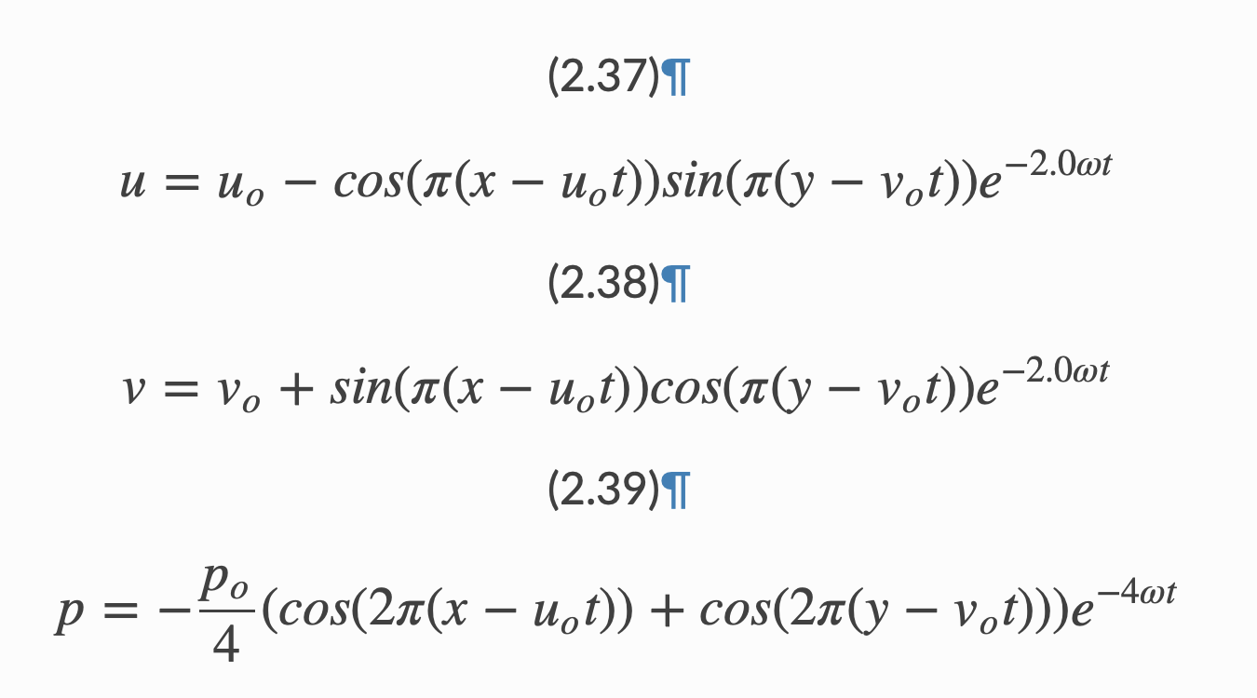
Consistent vs Lumped Mass Matrix
Goal: Explore the time accuracy of the consistent mass matrix approach on a structured mesh
Convecting Taylor Vortex Case Study: Analytical, transient verification problem
Process: Compute error at a specific time while refining mesh

Slide 6
Code or Conceptual Error? Part 1: Time Splitting
Case Study: An Algorithm is thought to be second-order-in-time accurate with one nonlinear iteration: True or False?
Issa, “Solution of the implicitly discretized fluid flow equations by operator splitting”, JCP (1985).
Advent of the “Pressure-implicit with Splitting of Operators”, or PISO
PISO is a scheme that defines a series of predictors and correctors in the context of a fully implicit solve
Conclusion?
Sometimes we code a method correctly, however, have a conceptual error in our understanding of whether or not a scheme is design-order accurate when run in the suggested manner

Slide 7
Code or Conceptual Error? Part 2: Boundary Conditions
Case Study: Using the convecting Taylor Vortex case, explore boundary conditions
Choice 1: Periodic with specified initial condition
Requires no formal boundary conditions
Choice 2: Inflow
Easy, velocity is specified as a Dirichlet
What about pressure? The default approach is to assume a zero normal pressure gradient (no-op) – similar to what would be found at a wall
A notion of a “spurious numerical boundary layer” (Gresho, 1995) shows a characteristic length δ ~ sqrt(νΔt) error
We also need to make sure that we are adequately converging the nonlinear system within the time step

Slide 8
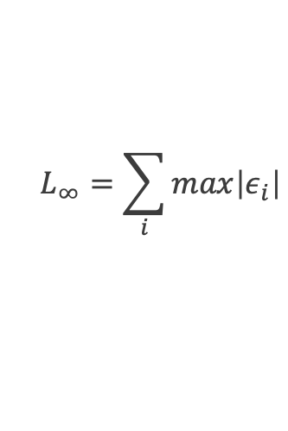
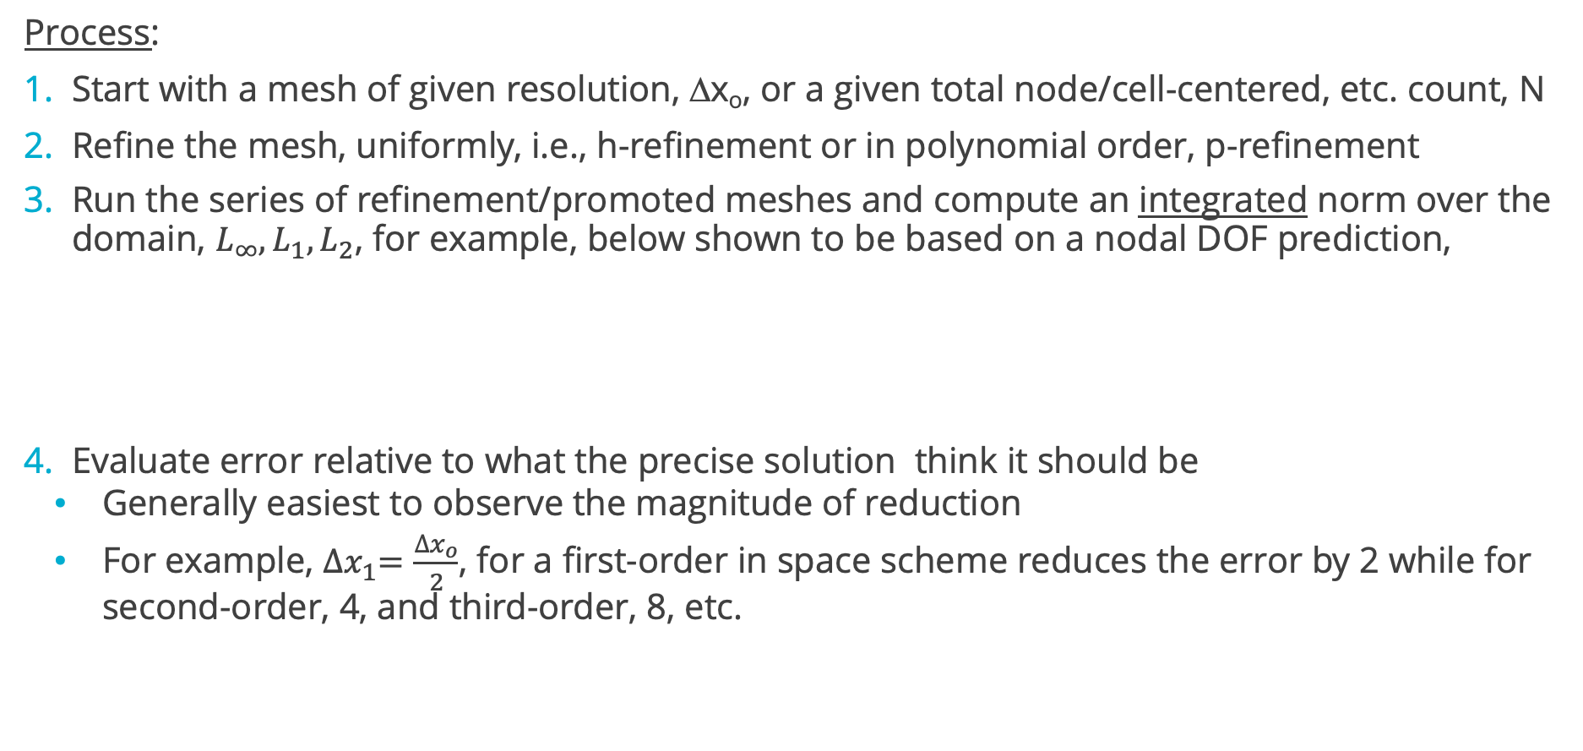
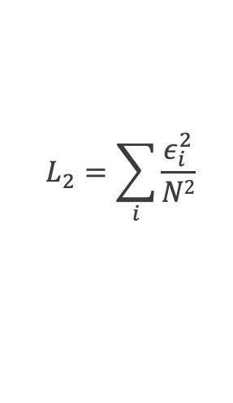
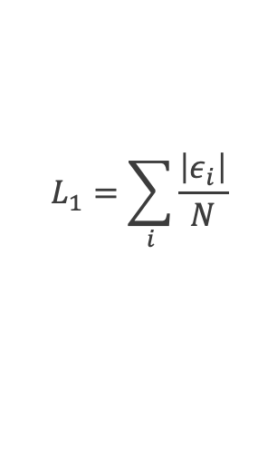
Spatial Verification Process
Process:
Start with a mesh of given resolution, Δx_{o}, or a given total node/cell-centered, etc. count, N
Refine the mesh, uniformly, i.e., h-refinement or in polynomial order, p-refinement
Run the series of refinement/promoted meshes and compute an integrated norm over the domain, $L_{∞}, L_{1}, L_{2}$, for example, below shown to be based on a nodal DOF prediction,
Evaluate error relative to what the precise solution think it should be
Generally easiest to observe the magnitude of reduction
For example, ${∆x}_{1}=\frac{{∆x}_{o}}{2}$, for a first-order in space scheme reduces the error by 2 while for second-order, 4, and third-order, 8, etc.
$$L_{∞}=\sum_{i}{max\left|ε_{i}\right|}$$
$$L_{1}=\sum_{i}{\frac{\left|ε_{i}\right|}{N}}$$
$$L_{2}=\sum_{i}{\frac{ε_{i}^{2}}{N2}}$$

Slide 9
Lurking, or Hidden Errors…
In some numerical implementations, an error can exist that is not easily found at a given mesh resolution
For example:
There may be a boundary error that manifests itself locally at a very small subset of the mesh
There may be an error that is a driven by the fidelity of the mesh (consider our specified pressure drop in a pipe example)
Other errors, e.g., for a discrete-ordinance method, we have an underlying quadrature error
s^{k}_{j}

Slide 10
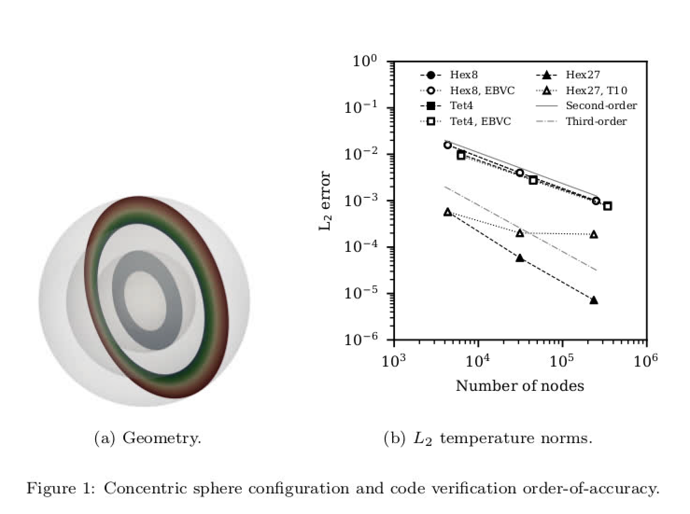
Lurking, or Hidden Errors…
In some numerical implementations, an error can exist that is not easily found at a given mesh resolution
For example:
There may be a boundary error that manifests itself locally at a very small subset of the mesh
There may be an error that is a driven by the fidelity of the mesh (consider our specified pressure drop in a pipe example)
Other errors, e.g., for a discrete-ordinance method, we have an underlying quadrature error
s^{k}_{j}

Slide 11
Lurking, or Hidden Errors…
In some numerical implementations, an error can exist that is not easily found at a given mesh resolution
For example:
There may be a boundary error that manifests itself locally at a very small subset of the mesh
There may be an error that is a driven by the fidelity of the mesh (consider our specified pressure drop in a pipe example)
Other errors, e.g., for a discrete-ordinance method, we have an underlying quadrature error
s^{k}_{j}
Quadrature error at given quadrate order

Slide 12
Temporal Verification: Fixed Spatial Resolution; Reduced Timestep
On a given mesh, compute error at a given time:

Slide 13
Temporal Verification: Fixed Spatial Resolution; Reduced Timestep
On a given mesh, compute error at a given time:

Slide 14
Temporal Verification: Fixed Spatial Resolution; Reduced Timestep
On a given mesh, compute error at a given time:

Slide 15
Temporal Verification: Fixed Spatial Resolution; Reduced Timestep
On a given mesh, compute error at a given time:
At a given mesh, the mesh
spacing is fixed and, eventually,
manifests itself

Slide 16
Temporal Verification: Reduction of Timestep as Mesh Is Refined
On a series of uniform mesh refinements, compute error at a given time while reducing time step
Must ensure that the spatial error does not dominate:
P1/P1
P2/P2
P1/P2
P2/P1
Traveling Vortex

Slide 17
Temporal Verification: Reduction of Timestep as Mesh Is Refined
On a series of uniform mesh refinements, compute error at a given time while reducing time step
Must ensure that the spatial error does not dominate:
P1/P1
P2/P2
P1/P2
P2/P1
Traveling Vortex
P2/P1

Slide 18
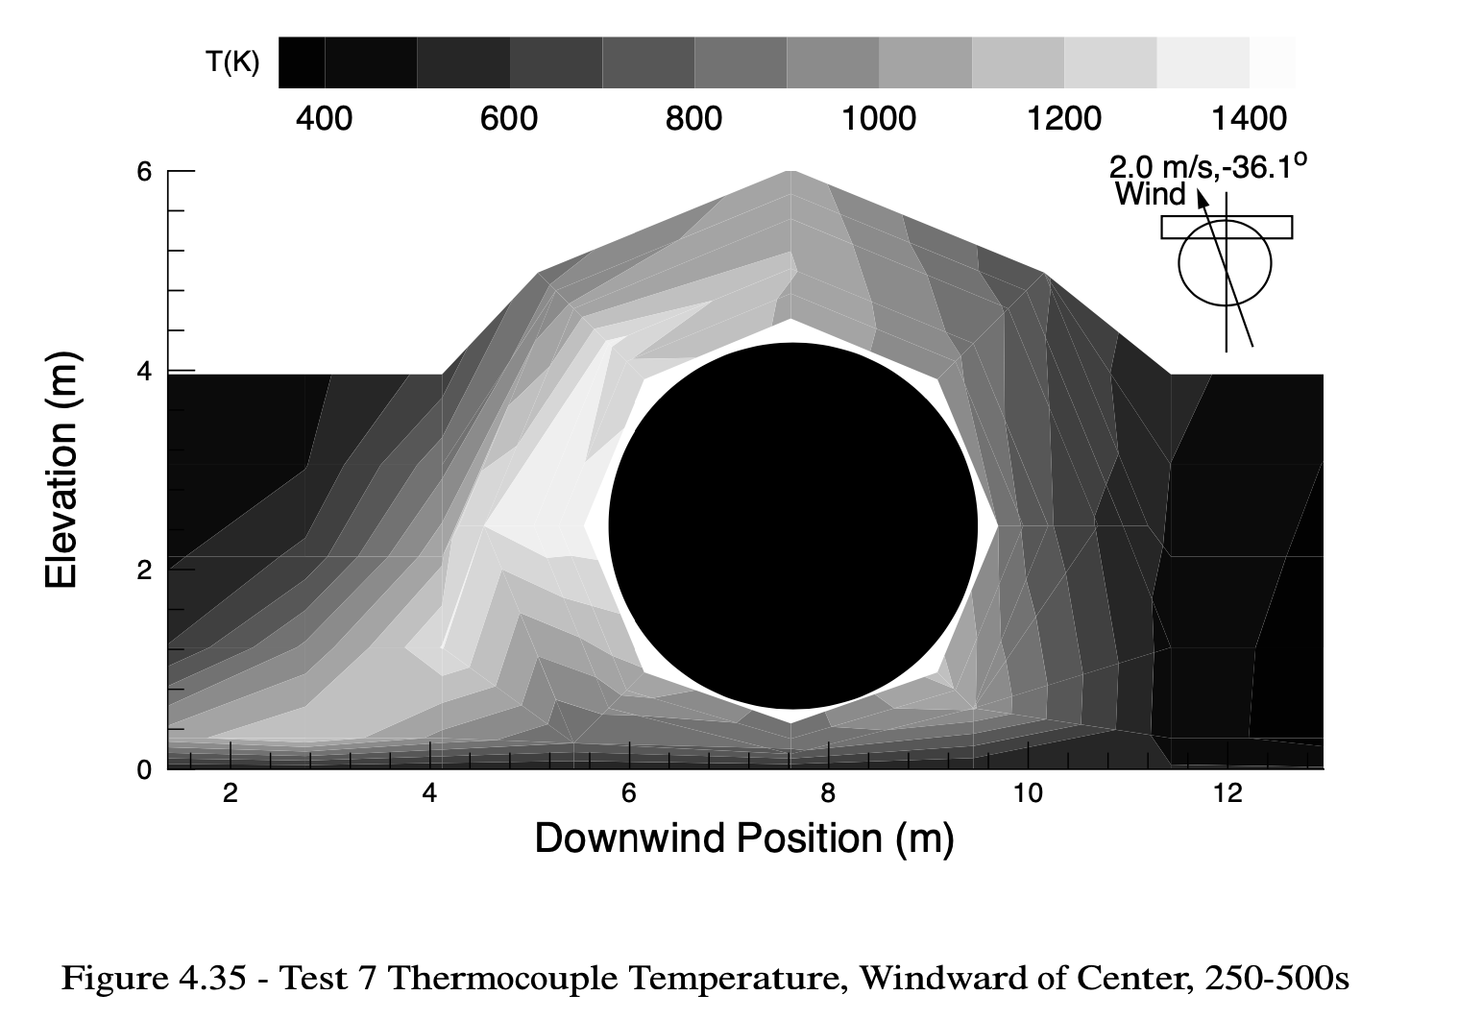
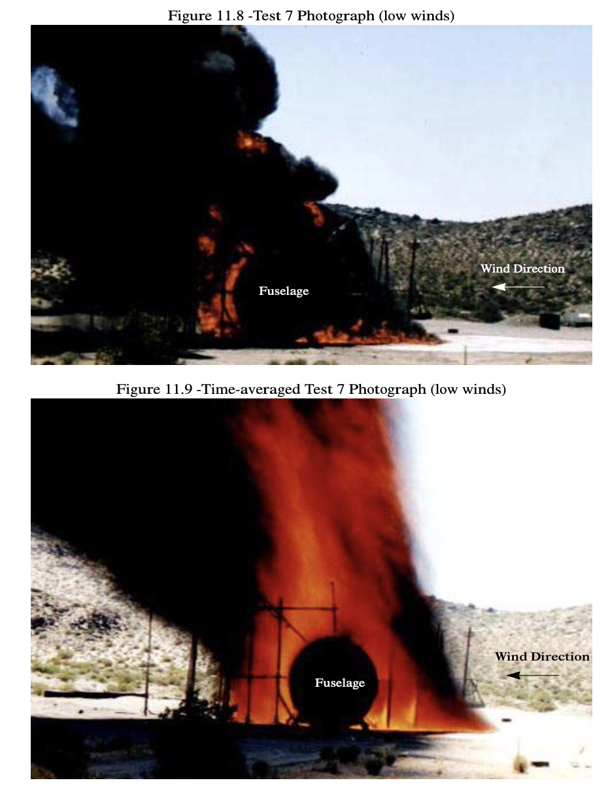
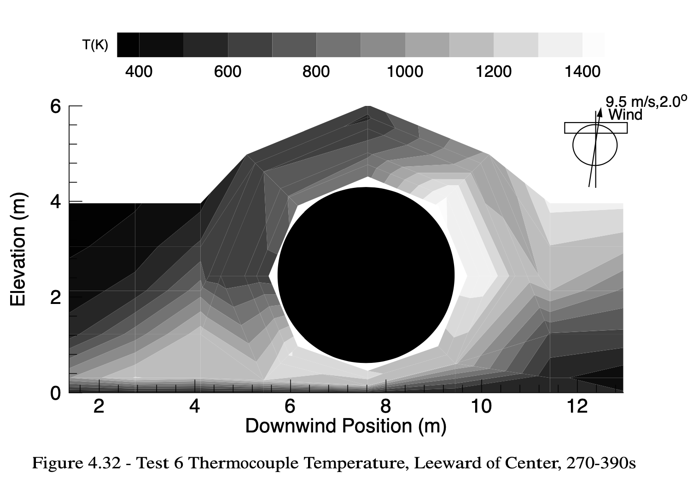

Domino et al., Phys. Review Fluids (2025): Fire-engulfed Object in X-wind: Can we predict windward→leeward migration of peak heat flux (and magnitude) using WMLES?
2.0 m/s
~220 kW/m²
(Windward)
T^{skin} ~1400
Wind
9.5 m/s
~320 kW/m²
(Leeward)
T^{skin} ~1400
Wind
Suo Antilla and Gritzo, “The Effects of Wind on Fire
Environments Containing Large Cylinders”, Comb. Sci.
Tech. (2008)

Slide 19
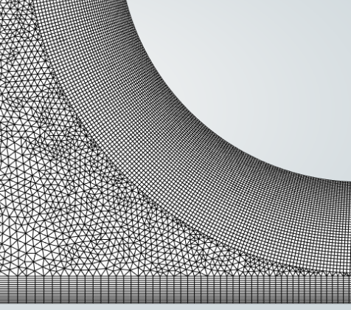
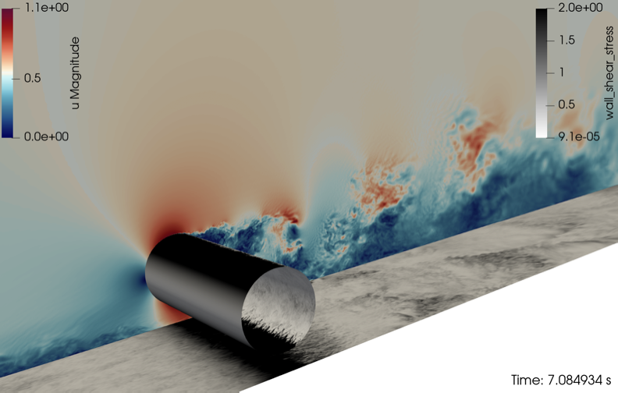
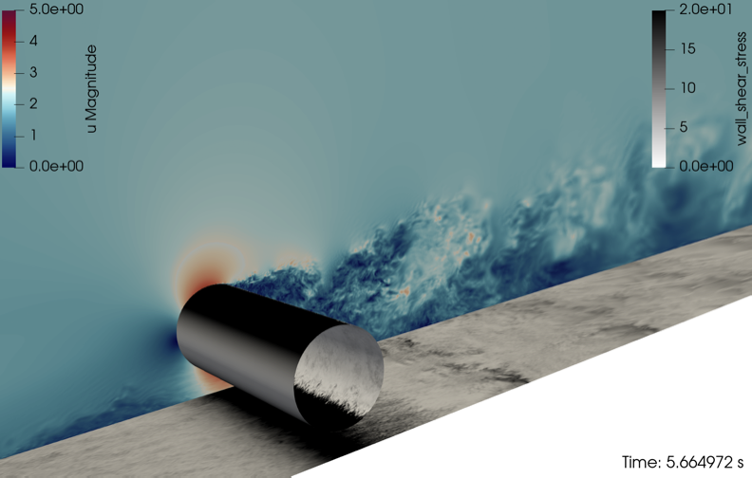
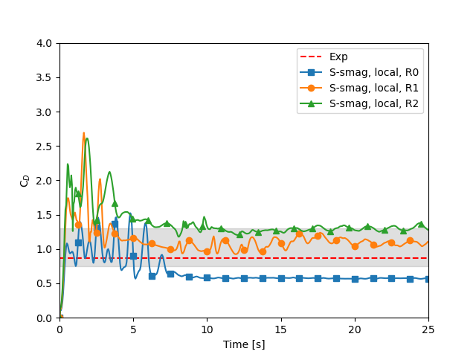
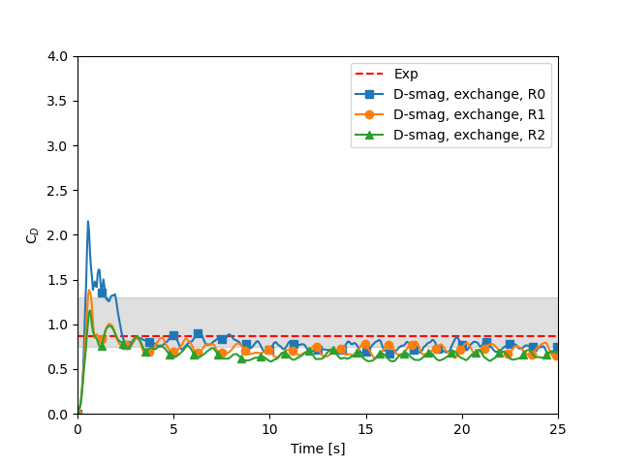
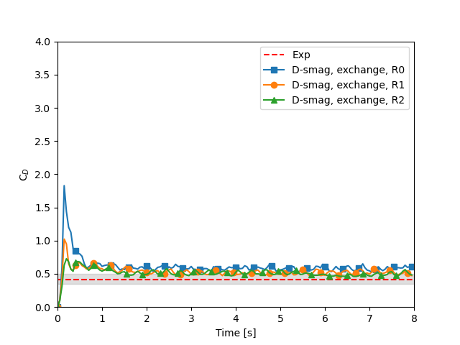
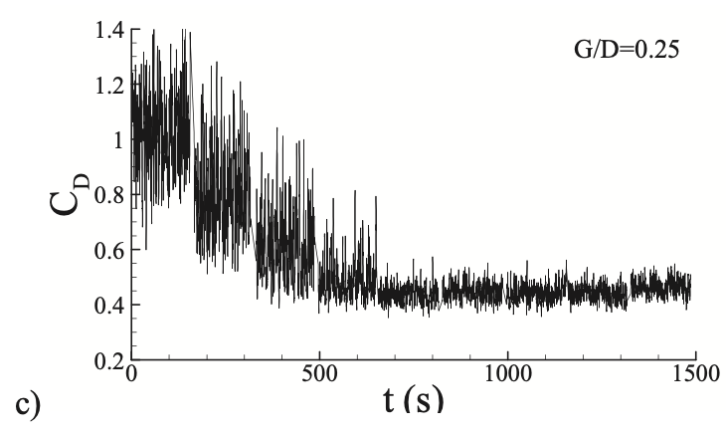
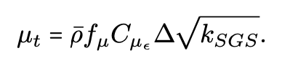
Step 1: Isothermal Crosswind Simulation Structural Uncertainty Study: Re 1.1x10⁵ and 4.3x10⁵ Simulations Gap (G) Diameter (D): G/D = 0.25
G/D = 0.25, Yang et al., Ocean Eng. (2018) mimics the fire-engulfed fuselage use case (sub/supercritical drag regime; drag crisis well-predicted)
Finding: Wall-modeled large-eddy simulation (WMLES) using a dynamic model with exchange-based velocity sampling increases predictivity (C_{D} & C_{p}) and convergence as a f(Δx)
O(600) million element mesh for Refinement 2!
Re 1.1x10⁵
Re 4.3x10⁵

Slide 20
Step 2: Fire V&V

Slide 21
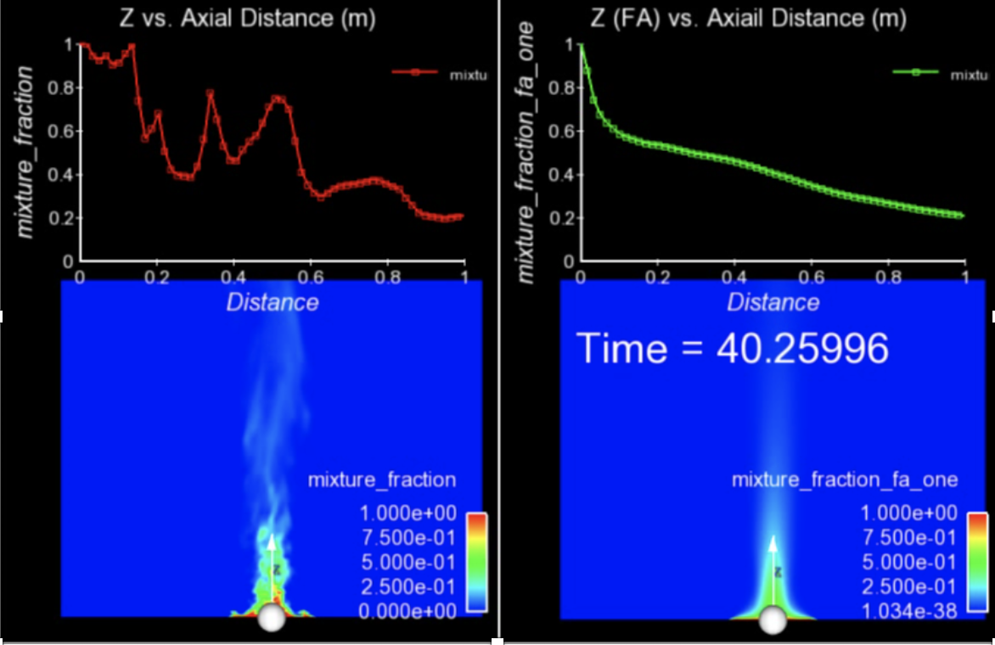
Finally…. For Transient Flows, Averaging is Required
The bane of turbulent validation: converged statistics require many flow-through times
Statistical convergence of a given simulation may require many flow-through-times; additional source of uncertainty and/or requirement for quantification of solution convergence

Slide 22
Essentials of Code Verification: Review
Taxonomy: One verifies code and validates models
Code verification establishes the numerical accuracy of the underlying discretization for the given partial differential equation set
Code verification seeks to provide the temporal and spatial accuracy of the underlying discretization approach
For temporal discretization error,
A two-state Backward Euler time integrator should be first-order in time, specifically the error should scale with Δt
A three-state BDF2 time integrator should scale with Δt²
A multi-stake Runge-Kutta schemes can achieve higher-order accuracy
For spatial discretization error,
A method is design-order if the observed order of accuracy is Δx^{P+1}, where P is the underlying basis polynomial order
Oberkampf and Trucano, Verification and validation in computational fluid dynamics, Progress in Aerospace Sciences,
Volume 38, Issue 3, 2002, https://doi.org/10.1016/S0376-0421(02)00005-2.

Slide 23
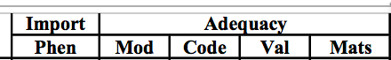
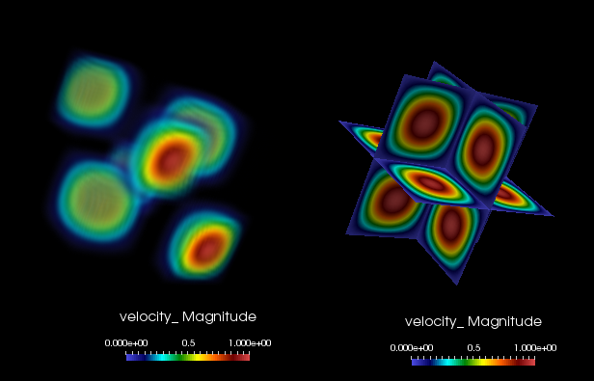
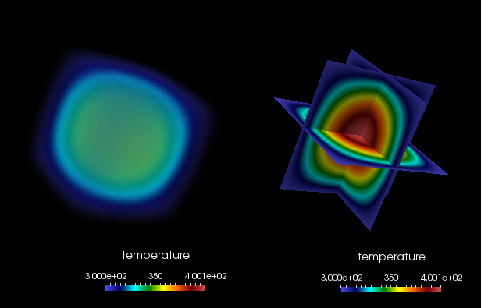
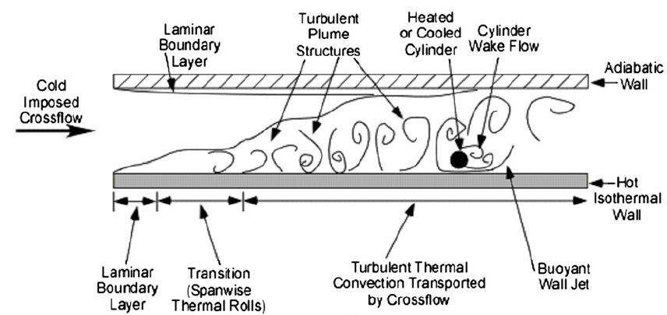
Spatial Code Verification for a low-Mach, Variable-Density Flow
Density is a function of static enthalpy transport via the standard ideal gas, ρ = f(P,M,R,T)
Temperature range maps to experiment (see below)
Arbitrary buoyancy source term via rotated gravity vector
Collective study now provides confidence in the interplay between numerical and modeling accuracy
See, “Exploring model-form uncertainties in large-eddy simulations”, Domino et al, 2016
Velocity Mag
Temperature
Kearney experimental configuration

Slide 24
Review of the Method of Manufactured Solutions (MMS): Providing confidence that the code implementation converges to the proper solution
We understand that the number of analytical solutions to test our code implementation are very few in number
How can we test the numerical accuracy of our implementation that, in general, solves very complex physics?
Specifically, as we refine the mesh and time step, how does the error respond?
Consider a simple heat conduction PDE:
With given [steady] manufactured solution:
New, analytically modified system that includes a new source term that we can implement in the code base:
The error is computed to be the difference between the analytical, or manufactured solution and our numerical simulation, T^{h}
We can now refine the mesh and timestep, while computing the error to ensure that the rate of reduction is expected
For example, if we believe our scheme is 2nd or 3rd order in space accuracy, one uniform refinement should reduce the error by 4x or 8x, respectively

